Slide 1
The use of concept maps as a teaching strategy was first developed by J. D. Novak of Cornell University in the early 1980's. It was derived from Ausubel's learning theory which places central emphasis on the influence of students' prior knowledge on subsequent meaningful learning. According to Ausubel, “the most important single factor influencing learning is what the learner already knows. Thus meaningful learning results when a person consciously and explicitly ties new knowledge to relevant concepts they already possess. Ausubel suggests that when meaningful learning occurs, it produces a series of changes within our entire cognitive structure, modifying existing concepts and forming new linkages between concepts. This is why meaningful learning is lasting and powerful whereas rote learning is easily forgotten and not easily applied in new learning or problem solving situations which the present science curricula so advocate.

Slide 2
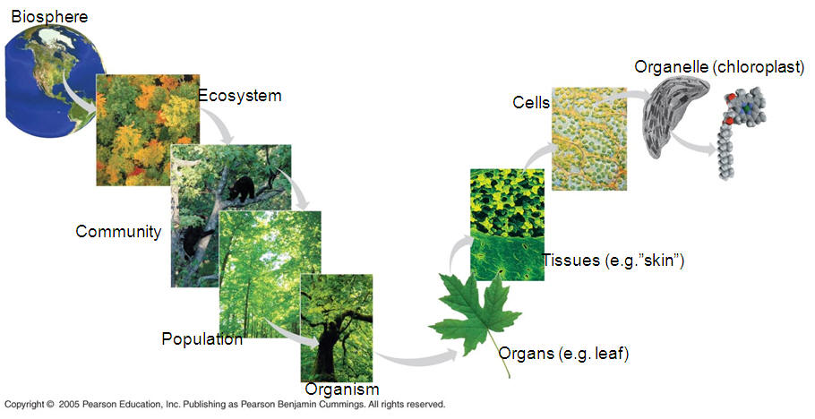
Give one example of a hierarchical organizing scheme commonly used in biology and list ecological constraints or limiting factors.

Slide 3
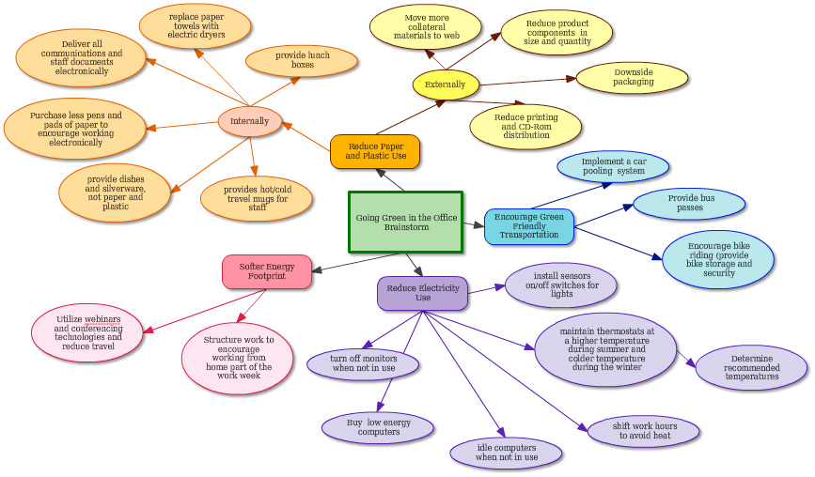

Slide 4
Steps in constructing concept maps
Select
  Focus on a theme and then identify related key words or phrases.
Rank
  Rank the concepts (key words) from the most abstract and inclusive to the most concrete and specific.
Cluster
  Cluster concepts that function at similar level of abstraction and those that interrelate closely.
Arrange
  Arrange concepts in to a diagrammatic representation.
Link and add proposition
  Link concepts with linking lines and label each line with a proposition.

Slide 5
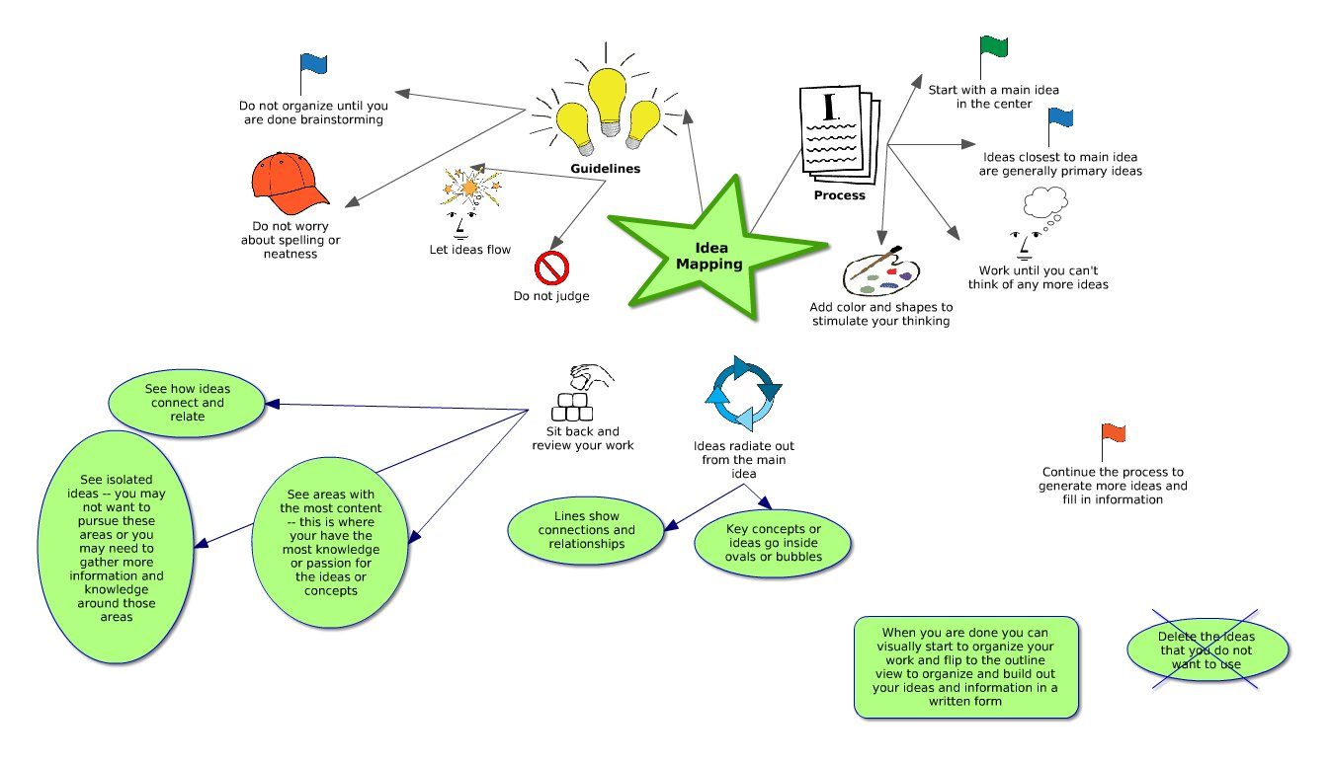

Slide 6
Smoke
Native
Plants
Natural Disturbance Processes
Politics
Maintain Healthy Native Ecosystems
Ecosystem
Services
Native
Animals
Natural
Ecosystem Function
Other gas emissions
Weather patterns
Global Fire
CO2 emissions
Climate
Change
Economics
Human health costs
Carbon Sequestration
Fire fighting costs
Human Interfaces
Developing Nations Few Dollars
Products
Developed Nations Billions of Dollars
Sustenance
Management

